Slide 1

Q2 2022
HR Technology Sector M&A Review

Slide 2



Q2 2022
HRTECH SECTOR
Introduction
As the second quarter of 2022 has passed, technology continues to improve, modernise and innovate the HR Technology sector – the introduction of new products, services and software is becoming a daily occurrence across the globe. to help improve access to online e-learning initiatives, streamline the recruitment process and enhance the employee experience.
In the age of ‘The Great Resignation’ where employees are quitting and switching jobs in record numbers, many employers are turning to personalised e-learning experiences, to help foster a culture of learning in the workplace and provide a career path for valuable talent. Nearly 49% of organisations have already increased their learning and development spend in 2022 and are implementing a combination of social learning, on-demand learning (resources, apps and e-learning platforms) and individualised learning (via podcasts, conferences and webinars).
Additionally, there has also been a focus on the digitisation of internal processes. HR Technology has taken on a whole new role and will continue to help businesses manage their people and operations from anywhere in the world. Secondly, many recruitment agencies and HR departments are utilising AI-driven SaaS software solutions to attract, hire and retain top talent, automate key people processes and transform the way they identify and develop the skills of the future.
Technology continues to improve, modernise
and innovate the HR Tech sector.
HR Technology Sector M&A Review

Slide 3

Q2 2022
The future of hr recruitment, e-learning & onboarding
The rise of hyper-personalised e-learning experiences
The workplace in the modern world is changing. Remote and hybrid working models have placed new demands on employees who may require a new set of skills to accommodate working from home. Employers are now adopting digital learning and development strategies to foster a culture of learning in the workplace, address skills gaps and upskill and reskill existing employees.
Artificial Intelligence (AI) has become one of the most popular e-learning trends in the business world today, with the world’s AI in the education market predicted to increase to $3.68 billion by 2023. This is mainly because of its ability to personalise learning and create hyper-personalised learning experiences and automate the creation of e-learning courses. Mobile-first courses are also in high demand too with the mobile learning market expected to reach more than $280 billion by 2027. Mobile devices allow greater accessibility for ‘on the go’ learners with 99% of learners stating that this form of learning improves their experience.
EduBrite, Careercake and Pellcomp (Trinity Software Limited) have all recently been acquired by leading e-learning solutions providers such as LinkedIn, SocialTalent and Pave, which showcases the increasing demand for personalized e-learning experiences.
An effective onboarding process can improve employee retention by up to 82%.
Payroll software and technology is here to stay
Many organisations are currently focused on global workforce issues such as the Environmental, Social and Governance (ESG) agenda and as a result, are transforming their Payroll, HR and Finance functions.
Payroll is integral to all organisations, which is why there has been an increasing demand for payroll technology and software to adapt to regulatory and compliance change, changing customer expectation and the ever-changing needs of employees and employers. In a hybrid working world, employers are now expanding their use of Artificial Intelligence (AI) and Robotic Process Automation (RPA) to reduce the risk of human errors, free up time for payroll teams and support the business with making more evidence-based, strategic decisions.
Technologies include SDWorx, a leading provider of integrated payroll and HR software solutions, designed to help mid-market and enterprise businesses deal with the complexities of modern workforce management. HRPro were acquired by SD Worx in June 2022.
HR Technology Sector M&A Review

Slide 4

Q2 2022
The future of hr recruitment, e-learning & onboarding
Leveraging AI and SaaS for talent acquisition
One of the many ways AI and SaaS software is shaping talent acquisition is by sourcing and engaging candidates through online job boards and platforms and is being used to score resumes and identify candidates best suited for the position.
A total of 96% of HR managers believe AI can improve talent acquisition and retention significantly and overcome the obstacle of finding the right candidate in high demand talent pools. From sourcing candidates through to employee onboarding and engagement, AI and SaaS software therefore has a significant impact on the recruitment process.
AI and SaaS software further enables recruiters and hiring managers to assess and interview candidates with more ease than traditional methods and essentially speed up time-to-hire. Given how fierce the war for talent is right now, recruiting managers who are utilizing data through the hiring funnel, finding new ways to source under-represented talent and thinking of talent acquisition as a long-term strategy, have a competitive advantage over the rest.
Software providers include Talentry, who’s technology offers an enterprise ready SaaS recruiting solution based on employee referrals (acquired by Clever Connect in June 2022).
The rise of virtual career fairs and events
As we enter the new age of hybrid working, virtual career fair software is making it easier for organisations to recruit across a much larger geographic area and attract global talent.
Many employers are now turning to virtual career fairs for finding job candidates, while also cutting out the costs involved of booking a physical event space, renting equipment and supplies and travel expenses for staff, involved in traditional career fairs.
Not only this, but virtual career fair software is providing employers with access to real-time information and allowing candidates to view presentations, attend virtual webinars, download materials and chat to the hiring manager(s) or company representatives.
Additionally, this type of software is also being used to portray company culture using 3D designs, animated avatars, lobbies and exhibition booths to enhance networking and engagement for employers and applicants.
Acquisitions in this space include TalentSpace, an online platform where interactive virtual & hybrid career fairs and hiring events are hosted (acquired by Handshake in April 2022).
Companies are increasingly leveraging AI and SaaS for talent acquisition to identity top talent in high demand talent pools.
HR Technology Sector M&A Review

Slide 5





Q2 2022
Q2 2022
M&A Overview
In this report, we highlight 40 of the 52 M&A transactions within the HRTech sector which completed during the second quarter of 2022. Overall deal volumes have decreased since the last quarter, by 16% and is marginally lower in the volume of deals compared to the same period of 2021.
The demand for top talent remains high across regions, countries, and industries this quarter, despite geopolitical friction and looming macro-economic headwinds. Progressive global organisations are building and enhancing holistic talent practices, with talent acquisition functions continuing to carry elevated expectations and heavy workloads. Smarter, tighter, and shorter hiring processes have become a key competitive advantage, connoting a responsive, agile, and talent-friendly culture. Talent management and development (which was muted relative to other HR specialisations during the pandemic) now has a renewed focus, driven by the need to retain existing talent.
Notably, talent attraction was hot area in M&A, with 44% of identified deals taking place in this space, followed by talent development and workforce management, representing 25% and 13% of the total deal volume, respectively.
Cross-border transactions accounted for 50% of the total and 90% of deals involved a strategic or PE-backed buyer. The most active regions in terms of HRTech M&A continue to be the US and Europe (mainly the UK), though the volume has declined in Asia.
Public Companies Overview
Q2 saw a decrease in average revenue multiples across our large cap but an increase in the mid cap sample of quoted companies. Tech sectors, including HRTech, are beginning to feel the impact of high inflation and an unsettled macroeconomic outlook. As of 30th June, the average forward revenue multiple overall was 5.1x, going up to 5.7x for Large Cap companies.
Revenue growth continues to be a critical driver of higher valuations. The companies exhibiting the highest expected revenue growth ReadyTech (people management software provider) and Paylocity (payroll and human capital management provider). Recurring revenue as a proportion of total revenues averaged above 80%, with Small Cap companies generating as much as 93.8% recurring revenues.
HRTech Subsectors
Compensation and Benefits
HR software relating to the management of employee compensation and benefits administration
Performance Management
Systems to track, measure and reward employee performance
Talent Attraction
Tools to help employers recruit new staff and to help prospective employees search for jobs
Talent Development
HR software providing the means to train and develop an effective workforce
Workforce Management
HR software that facilitates ‘everyday’ HR work and the management of employees
HR Technology Sector M&A Review

Slide 6




Q2 2022
DEALS SNAPSHOT
Transaction Value: $400m
Revenue Multiple: N/A
Transaction Value: $200m
Revenue Multiple: N/A
Founded in 2013, GoodHire provides FCRA-compliant pre-employment screening solutions for small and medium sized businesses. GoodHire scours databases of various organisations including criminal records, terrorist watch check, vehicle checks, employment verification etc.
This acquisition is a critical part of Checkr's expansion strategy in its fastest growing small-to-medium sized (SMB) business segment. GoodHire serves tens of thousands of customers in this segment.
Companies of all sizes now expect digital tooling and a great candidate experience to win the war for talent — the kind delivered by innovative gig companies like Uber and Doordash. With this acquisition, Checkr is positioned to bring an innovative, best-in-class software platform to customers of all sizes - now including small businesses as well.
Checkr CEO Daniel Yanisse described the acquisition as the coming together of two of the most innovative companies in the background check industry. Their teams have much in common, he said, including similar cultural values and “a focus on building delightful experiences for customers.”
Founded in 1985, SumTotal Systems is a provider of learning, performance and talent development software products. The company offers contextual and pervasive HR solutions spanning the entire employee lifecycle that help improve employee performance in real-time, enabling organisations to discover, develop and unleash the hidden potential within their workforce and entire business ecosystem.
With the addition of SumTotal, Cornerstone will be positioned to help a larger, more diverse group of customers transform the way they identify and develop the skills of the future, engage and develop their people, and optimise talent and business agility. The combined company will be positioned to deliver a differentiated, expanded portfolio of learning, talent, and people growth solutions with broader vertical expertise, greater financial resources, and a shared vision for the future of work.
SkillSoft, the owners of SumTotal, believe that through the divestiture of SumTotal that they are aligning and simplifying Skillsoft’s portfolio to serve customers and focus the business on the best opportunities for profitable growth.
This announcement follows Cornerstone’s recent acquisition of EdCast, which has fuelled the company’s strategy to create an open platform for people development, growth, and mobility.
HR Technology Sector M&A Review

Slide 7

Q2 2022
M&A HIGHLIGHTS Q2 2022
$1.0bn
Aggregate Deal Value
Deals by Subsector
$144m
Average Deal Size
4.9x
Average Revenue Multiple
Europe
Buyers
24
Targets
20
Asia-Pacific
Buyers
3
Targets
4
North America
RoW
Buyers
23
Targets
19
Buyers
4
Targets
4
HR Technology Sector M&A Review

Slide 8

Q2 2022
SELECTED TRANSACTIONS:
TALENT ATTRACTION
DATE | BUYER | TARGET | DESCRIPTION | DEAL SIZE ($'m) | TARGET REVENUE ($'m) | REVENUE MULTIPLE (x) | TRANSACTION RATIONALE
Apr-22 | Hirewell (US) | Rainmakers (US) | A reverse-recruitment marketplace focused on tech salespeople | n/a | n/a | n/a | Working with Hirewell will allow Rainmakers to significantly expand Rainmakers' sales talent marketplace while continuing to build out the Rainmakers technology stack, further cementing Rainmakers as the go-to hiring platform for salespeople.
Apr-22 | Zvoove Group (Germany) | Pivoton (Netherlands) | A SaaS provider in the Dutch market for temporary staffing software that allow customers to establish efficient and legally compliant processes from recruiting to billing and payment of employees. | n/a | n/a | n/a | The merger has a high strategic value for Zvoove and further expands Zvoove's European market leadership. At the same time, Zvoove's customers in Germany and Switzerland will benefit from the transaction, as there is now more temporary staffing market experts within Europe which are driven to deliver further competitive advantages via innovative software to customers.
Apr-22 | Checkr (US) | GoodHire (US) | GoodHire is an employment screening provider working to ensure both companies and job candidates are treated fairly and with respect. | 400.0 | n/a | n/a | This acquisition is a critical part of Checkr's expansion strategy in its fastest growing small-to-medium sized (SMB) business segment. GoodHire serves tens of thousands of customers in this segment.
Apr-22 | Handshake (US) | Talentspace (Germany) | A platform where interactive virtual & hybrid career fairs and hiring events are hosted. | n/a | n/a | n/a | Talentspace will strengthen Handshake's suite of events products while accelerating the company's expansion into Europe, where education-to-employment resources and career services offices are limited.
Apr-22 | HelloWork (France) | Basile (France) | A dedicated solution that allows the deployment, animation and management of referral programs. | n/a | n/a | n/a | Joining the digital recruitment business will allow Basile to accelerate growth further, strengthening our market position and pursuing the ambition to become the co-option recruitment benchmark in France, and around the world in future.
HR Technology Sector M&A Review

Slide 9
Q2 2022
SELECTED TRANSACTIONS:
TALENT ATTRACTION
DATE | BUYER | TARGET | DESCRIPTION | DEAL SIZE ($'m) | TARGET REVENUE ($'m) | REVENUE MULTIPLE (x) | TRANSACTION RATIONALE
Apr-22 | Beamery (UK) | Flux (US) | Flux's internal mobility platform connects employees looking to grow their careers with the most impactful work at the company. | n/a | n/a | n/a | With the acquisition of Flux, Beamery will offer the first unified platform for internal and external resourcing, allowing businesses to tap into the skills of their global talent pool, and recruit, find, develop, and redeploy people “on-demand.
Apr-22 | Jobandtalent (Spain) | Jobzone (Norway) | A staffing agency that offers recruitment and hiring services for construction and manufacturing industries. | n/a | n/a | n/a | Jobandtalent said the transaction will help strengthen its position in Scandinavia and will give Jobzone access to its platform.
May-22 | Acceleration Partners (US) | Grovia (US) | Designer and developer of a marketing recruitment platform that offers to discover, recruit, and activate digital partners. | n/a | n/a | n/a | The Seattle-based company strengthens Acceleration Partners' existing suite of partnership marketing services with a powerful recruitment platform that helps companies discover high-quality affiliates, influencers and publishers at scale.
May-22 | Zoominfo Technologies (US) | Comparably (US) | A leading recruitment marketing and employer branding platform, to enable companies to proactively attract and engage top talent. | 145.0 | n/a | n/a | The acquisition of Comparably adds another key source of company, employee, and customer data to ZoomInfo’s wealth of world-class data and intelligence. ZoomInfo plans to use Comparably’s unique proprietary data to further build TalentOS into a best-in-class talent platform by enriching recruiter search options and providing recruiters with access to millions of quality candidates and employer brand solutions.
May-22 | Crosschq (US) | TalentWall (US) | A hiring management platform that allows companies to hire more efficiently and with greater transparency. | n/a | n/a | n/a | The acquisition expands Crosschq's solutions, enabling recruiters and talent leaders to visualise and analyse hiring funnels while strategically planning for future hiring needs. Combining these capabilities with Crosschq's existing tools for sourcing and screening job candidates, as well as measuring Quality of Hire, will deliver the recruiting technology industry's most comprehensive platform that supports better hiring decisions by putting data at the core.
HR Technology Sector M&A Review

Slide 10
Q2 2022
SELECTED TRANSACTIONS:
TALENT ATTRRACTION
DATE | BUYER | TARGET | DESCRIPTION | DEAL SIZE ($'m) | TARGET REVENUE ($'m) | REVENUE MULTIPLE (x) | TRANSACTION RATIONALE
Jun-22 | Clever Connect (France) | Talentry (Germany) | Talentry offers an enterprise-ready SaaS recruiting solution based on employee referrals. | n/a | n/a | n/a | Together, the French and German companies want to counteract the current unprecedented shortage of skilled workers – by using the most efficient and advanced technologies to help recruiters on a daily basis and offer fulfilling candidate experiences.
Jun-22 | Adzuna (UK) | Getwork (US) | An AI-driven real-time employee experience SaaS platform, which was developed for employees, HR professionals and managers. | n/a | n/a | n/a | With the addition of Yva.ai to its product portfolio, Visier becomes the most comprehensive platform available for understanding employees from every dimension–and the ability to use these insights to drive positive outcomes for the company, the manager, and for the employee.
Jun-22 | Grupa Pracuj (Poland) | softgarden e-recruiting (Germany) | softgarden e-recruiting GmbH develops and offers human resource software solutions that connects employers with job seekers. | 125.0 | n/a | n/a | Through this strategic acquistion, Softgarden expands its product offering beyond recruitment to include features such as time-tracking, vacation and absence management as well as digital personnel file management.
Jun-22 | Revelo (Brazil) | Listopro (Mexico) | The leading platform to hire top digital talent in Latin America, by helping companies save time on sourcing whilst candidates save time on sending infinite applications. | n/a | n/a | n/a | With the acquisition of Listopro, Revelo, already the largest platform for sourcing, hiring and managing remote tech talent in US time zones, becomes the undisputed leader in providing US companies access to high-quality Latin American talent with its network of 300,000 developers.
Jun-22 | PROMAN Group (France) | Youbahn (Netherlands) | Youbahn is a temporary employment platform that helps students to find jobs. | n/a | n/a | n/a | The labour market is on the eve of rigorous change. In the near future, branches such as the hospitality industry, logistics and healthcare will offer work even more flexibly. And that without compromising on laws and regulations and the duty of care of employers. With the Youbahn platform, strongly focused on the gig economy, Youbahn believe that that can be done with a strong partner such as Proman.
HR Technology Sector M&A Review

Slide 11
Q2 2022
SELECTED TRANSACTIONS:
TALENT ATTRRACTION
DATE | BUYER | TARGET | DESCRIPTION | DEAL SIZE ($'m) | TARGET REVENUE ($'m) | REVENUE MULTIPLE (x) | TRANSACTION RATIONALE
Jun-22 | PROMAN Group (France) | In Person (Netherlands) | An online portal that offers job vacancies, recruitment, and HR services to its candidates. | n/a | n/a | n/a | According to Proman, the acquisition allows it to continue its external growth dynamic with family-owned companies in high-potential countries.
Jun-22 | Jobandtalent (Spain) | Jump (UK) | Specialises in technological job search through artificial intelligence (AI). | n/a | n/a | n/a | With this acquisition, the Spanish company has already completed more than ten transactions that complement its marketplace for connecting workers to companies. The deal shows Jobandtalent's drive for innovation and further strengthens the company's position as a market leader in job matching technologies.
HR Technology Sector M&A Review

Slide 12

Q2 2022
SELECTED TRANSACTIONS:
TALENT DEVELOPMENT
DATE | BUYER | TARGET | DESCRIPTION | DEAL SIZE ($'m) | TARGET REVENUE ($'m) | REVENUE MULTIPLE (x) | TRANSACTION RATIONALE
Apr-22 | Crehana (Peru) | Acsendo (Colombia) | Acsendo, helps companies to align its employees, in order to achieve their goals and succeed in their Strategy. | n/a | n/a | n/a | The acquisition of this company will strengthen its product through the integration of human talent software with solutions for work engagement, performance measurement, objectives, skills, recognition, culture, succession plans and more.
Apr-22 | Kazoo (US) | WorkTango (Canada) | Developer of a Software as a Service (SaaS) platform that helps companies to give their employees a voice and collect feedback. | n/a | n/a | n/a | Through this acquisition, Kazoo will expand its capabilities with WorkTango's comprehensive employee listening solution that gathers employee feedback via configurable templates, intelligently analyses the data in automated dashboards, and recommends next steps for people leaders based on those insights. Additionally, Kazoo will leverage WorkTango's expertise in data, analytics, and AI across the platform to unlock a more complete understanding of an employee's day-to-day experience.
May-22 | Visier (Canada) | Yva.ai (US) | An AI-driven real-time employee experience SaaS platform, which was developed for employees, HR professionals and managers. | n/a | n/a | n/a | With the addition of Yva.ai to its product portfolio, Visier becomes the most comprehensive platform available for understanding employees from every dimension–and the ability to use these insights to drive positive outcomes for the company, the manager, and for the employee.
May-22 | Zucchetti Worldwide (Italy) | Eggup (Italy) | A company that has developed a digital platform for assessing and improving the transversal skills of personnel. | n/a | n/a | n/a | The acquisition is part of Zucchetti's broader Human Revolution project, aimed at the complete digitalisation of personnel management processes , with the aim of increasing the effectiveness and efficiency of a company.
May-22 | Pluribus Technologies (Canada) | Knowledge Strategies (US) | Offers learning management systems, interactive eLearning solutions, and employee training for businesses. | 1.9 | n/a | n/a | This acquisition further strengthens Pluribus' presence in the eLearning market and as a provider of learning management systems suitable for a range of organisation types.
HR Technology Sector M&A Review

Slide 13
Q2 2022
SELECTED TRANSACTIONS:
TALENT DEVELOPMENT
DATE | BUYER | TARGET | DESCRIPTION | DEAL SIZE ($'m) | TARGET REVENUE ($'m) | REVENUE MULTIPLE (x) | TRANSACTION RATIONALE
May-22 | Personio (Germany) | Back Technologies (Germany) | An employee experience solution that automates key people processes to boost efficiency. | n/a | n/a | n/a | The acquisition supports Personio’s strategic direction to advance and expand the People Workflow Automation category, which enables HR teams in SMEs to work efficiently across departments and tools.
May-22 | ServiceNow (US) | Hitch Works (US) | A SaaS-based talent mobility platform for the enterprise that accelerates the productivity and performance of existing talents. | n/a | n/a | n/a | Together, ServiceNow and Hitch will help companies provide equal access to work and development opportunities, regardless of who an employee knows or how well they network. This acquisition is another investment ServiceNow is making to enhance employee experiences and power the future of work by unlocking skills intelligence on a single platform within the ongoing flow of work.
Jun-22 | Cornerstone (US) | SumTotal Systems (US) | Developer of talent acquisition, onboarding, learning management, and talent management solutions. | 200.0 | 120.0 | n/a | With the addition of SumTotal, Cornerstone will be positioned to help a larger, more diverse group of customers transform the way they identify and develop the skills of the future, engage and develop their people, and optimise talent and business agility. The combined company will be positioned to deliver a differentiated, expanded portfolio of learning, talent, and people growth solutions with broader vertical expertise, greater financial resources, and a shared vision for the future of work.
Jun-22 | LinkedIn (US) | EduBrite (US) | A professional networking site that allows its members to create business connections, search jobs, and find potential clients. | n/a | n/a | n/a | By integrating EduBrite’s rigorous certification assessment engine into LinkedIn Learning platform, LinkedIn will be able to better test and verify the skills people have to help them grow in careers and enable them to earn trusted credentials from organisations that can be shown on a LinkedIn profile. This will help LinkedIn further deliver on the vision to create a skills-first approach to hiring and learning.
HR Technology Sector M&A Review

Slide 14

Q2 2022
SELECTED TRANSACTIONS:
workforce management solutions
DATE | BUYER | TARGET | DESCRIPTION | DEAL SIZE ($'m) | TARGET REVENUE ($'m) | REVENUE MULTIPLE (x) | TRANSACTION RATIONALE
Apr-22 | WorkChew (US) | Kettle (US) | KettleOS is a software platform purpose-built to give teams the ability to orchestrate when, where, and why they work together in-person. | n/a | n/a | n/a | The acquisition helps WorkChew continue to meet rising demand from companies looking for agile workspace solutions as they roll out post-pandemic hybrid work models where employees work in and outside the office.
Apr-22 | Visma (Norway) | Woffu (Sweden) | A time management platform that allows you to easily organize holidays and absences of the company's human team. | n/a | n/a | n/a | Joining Visma will give Woffu a number of benefits that will allow it to meet customer needs even better than before. Woffu will maintain its leadership and culture while benefiting from Visma’s international network, expertise, and complementary products.
May-22 | BetterPlace Safety Solutions (India) | OkayGo (India) | An on-demand blue-collared gig workforce management platform. | n/a | n/a | n/a | Through this acquisition, BetterPlace will aim to provide opportunities for India’s 90 million strong gig-workforce by enhancing ‘BetterPlace Select,’ the company’s short-term, long-term and task-based workforce management offering.
May-22 | Stone Capital Partners (US) | Beeline (Puerto Rico) | Offers workforce intelligence solutions for companies to manage their contractor and project-based labour force. | n/a | n/a | n/a | The strategic investment will allow Beeline to further accelerate its leading technology platform and bring additional solutions to market, helping businesses unlock the power of the extended workforce.
May-22 | Cegid (US) | StorIQ (US) | StorIQ is a neat and intuitive retail operations app that saves time and makes life easier for store teams and retail management teams. StorIQ streamlines communications and task management. | n/a | n/a | n/a | By capitalising on the current offerings of Cegid and StorIQ, brands and retailers will be able to offer an exceptional unified shopping experience across their entire store network while tapping into new sales opportunities and thus making in-store team task management.
HR Technology Sector M&A Review

Slide 15

Q2 2022
SELECTED TRANSACTIONS:
COMPENSATION AND BENEFITS
DATE | BUYER | TARGET | DESCRIPTION | DEAL SIZE ($'m) | TARGET REVENUE ($'m) | REVENUE MULTIPLE (x) | TRANSACTION RATIONALE
Apr-22 | Main Capital Partners (Netherlands) | BCS (Netherlands) | Developer of human resources management (HRM) and payroll software. | n/a | n/a | n/a | Main has extensive experience in the payroll and HRM market through previous investments in Germany, the Netherlands and Sweden, such as Perbility (HR software), SDB (HR payroll solutions for healthcare institutions), Textkernel (AI software for HR) and Assessio (e-assessment tools and talent management). This experience and market knowledge will be used to support BCS in the next phase of growth.
Jun-22 | Deel (US) | PayGroup (Australia) | A US-based global payroll and compliance firm. | 82.2 | 16.7 | 4.9 | To meet the demands of an increasingly distributed and remote workforce, Deel is working on a payroll offering that lets businesses consolidate their local entity payroll solutions into one easy-to-use dashboard for both contractors and employees. PayGroup’s services perfectly complement these efforts.
Jun-22 | Pave (US) | Advanced-HR (US) | Provider of compensation data and compensation planning software for private and venture backed companies. | n/a | n/a | n/a | Pave will acquisition momentum to accelerate its path towards becoming the world's premiere global compensation platform. The new acquisition of Advanced-HR will also accelerate Pave's European market expansion.
HR Technology Sector M&A Review

Slide 16

Q2 2022
SELECTED TRANSACTIONS:
performance management
DATE | BUYER | TARGET | DESCRIPTION | DEAL SIZE ($'m) | TARGET REVENUE ($'m) | REVENUE MULTIPLE (x) | TRANSACTION RATIONALE
Apr-22 | UOL EdTech (Brazil) | Qulture.Rocks (Brazil) | Provider of web and mobile real-time performance management platform for companies. | n/a | n/a | n/a | This acquisition enables WilsonHCG to provide even more comprehensive real-time talent insights to help organisations attract and retain talent.
May-22 | Advanced Computer Software Group (UK) | Decision Time (UK) | Developer of governance, risk, and strategic performance management software platform. | n/a | n/a | n/a | Advanced have found a highly complimentary partner that can take them to the next level as Decision Time are strategically aligned with the goal of being a leading software and services business in the healthcare
May-22 | Visma (Norway) | Mandü (Peru) | An innovative SaaS company for Employee Engagement & Performance Management in Peru. | n/a | n/a | n/a | This acquisition allows Visma to expand its HR product footprint across several countries in Latin America, while offering customers technology that helps them create added value.
May-22 | Cegid (France) | Wittyfit (France) | A platform for managing the employee experience, which supports companies on all subjects impacting their human capital. | n/a | n/a | n/a | With the acquisition of Wittyfit, Cegid is strengthening its investment strategy and leading position in the cloud talent and talent management market.
HR Technology Sector M&A Review

Slide 17
Q2 2022
PUBLIC COMPS HIGHLIGHTS Q2 2022
5.1x
Avg. EV/Revenue CY2022E
Historic Revenue Multiples
Large Cap
5.7x | 27% | 85.5%
Avg. EV/Revenue | Avg. Revenue Growth | % Recurring Revenue
Mid Cap
4.9x | 7% | 73.6%
Avg. EV/Revenue | Avg. Revenue Growth | % Recurring Revenue
Small Cap
2.2x | 20% | 93.8%
Avg. EV/Revenue | Avg. Revenue Growth | % Recurring Revenue
23%
Avg. Revenue Growth CY2021
86%
% Recurring Revenue
Revenue Growth Distribution
EBITDA Margin Distribution
Number of Companies
Number of Companies
HR Technology Sector M&A Review

Slide 18
Q2 2022
GOLDENHILL HRTECH INDEX
HR Technology Sector M&A Review

Slide 19
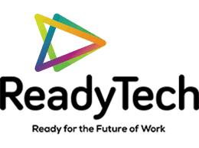







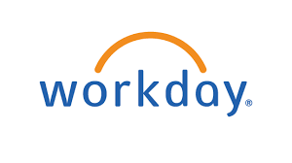





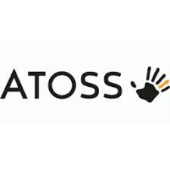

Q2 2022
PERFORMANCE QUADRANTS
The Rule of 40 is a recognised measure of health for SaaS companies, which states that Revenue Growth % and EBITDA Margin (profitability) should ideally add up to
roughly 40%.
HIGHER MARGINS
HIGHER
GROWTH
HR Technology Sector M&A Review

Slide 20





Q2 2022
REVENUE GROWTH AS A VALUE DRIVER
Revenue growth continues to be one of the most important drivers for higher valuations. The companies exhibiting the highest expected revenue growth this year are Fiverr (freelancing marketplace) and Ready Tech (people management software provider) and LTG (talent development software provider).
HR Technology Sector M&A Review

Slide 21
Q2 2022
SECTOR VALUATION METRICS
(1) Excludes treasury shares; (2) Net financial debt minus marketable securities and collaterals; (3) Recurring revenues (renewing licences, maintenance, subscriptions, SaaS etc.) where reported for last full year; (4) NM - Not meaningful and NA - Not available
HR Technology Sector M&A Review

Slide 22

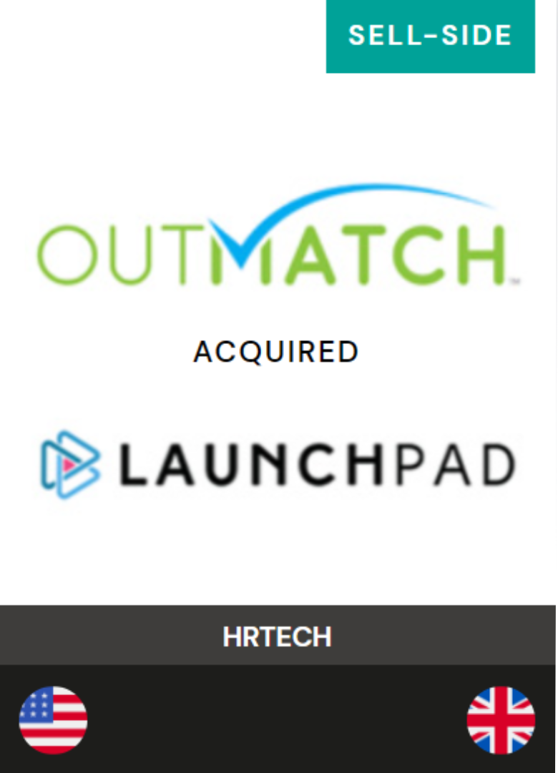
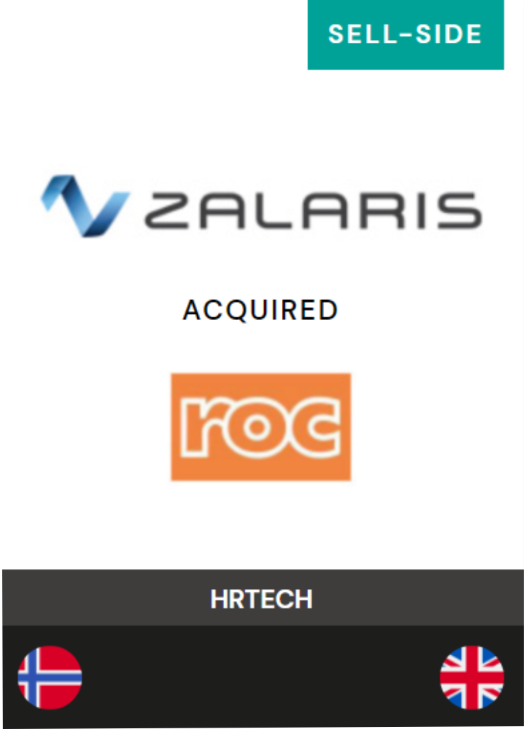
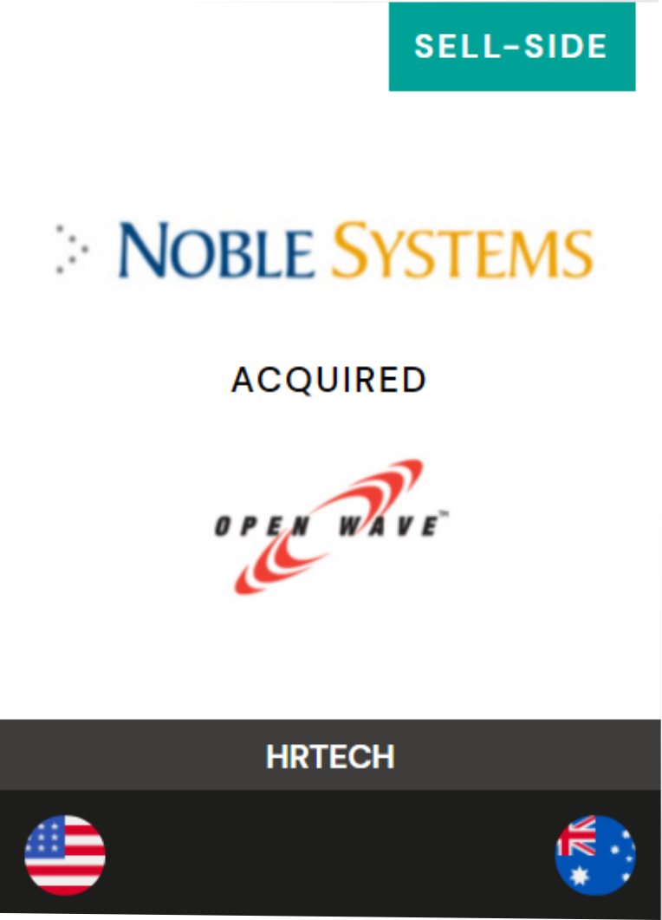




Quick Facts
Sector experts focused on providing advisory services to sellers and buyers in M&A projects across the globe.
Deep domain expertise across software, services and data intensive sectors, with a focus on FinTech, HRTech and Workforce Solutions.
Our Partners have advised on 100+ transactions with values ranging from $15 million to over $100 million; the majority (70%) of our engagements result in cross-border transactions.
International presence with offices in London, Milan, San Diego, Luxembourg, and Buenos Aires.
Proven track record of successful long-term advisory relationships positioning clients for premium transactions using current insights into the relevant strategic acquirers.
Philip Albright
London
William Berrington
London
Kevin O’Neill
San Diego
Carlos Ratto
Milan

